Slide 1

Fezzari sales
By kaviyarasan

Slide 2
INTRODUCTION TO THE COMPANY

Slide 3
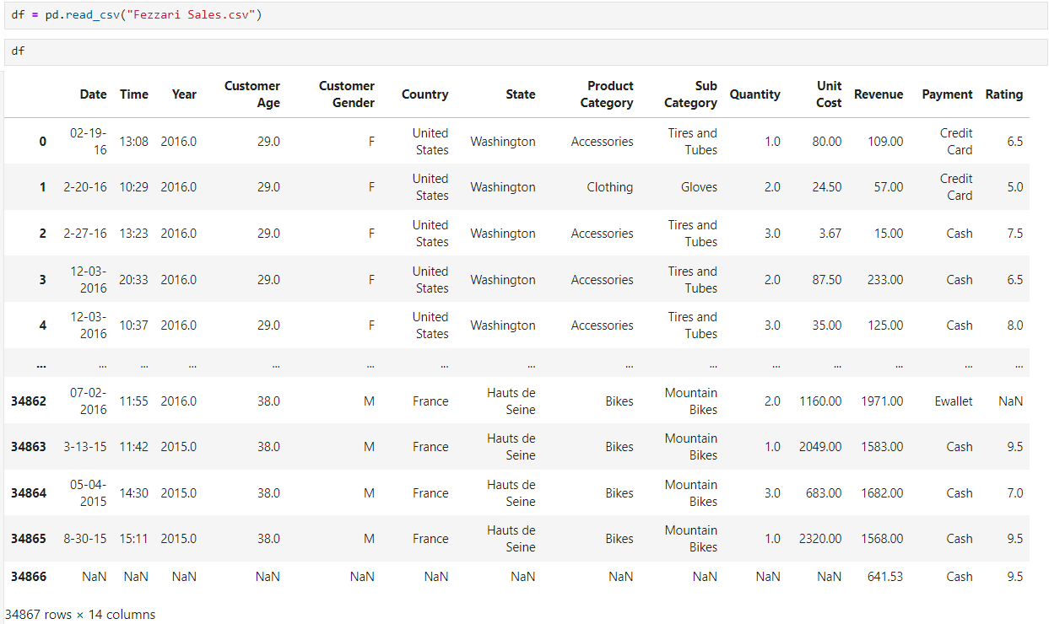

Slide 4
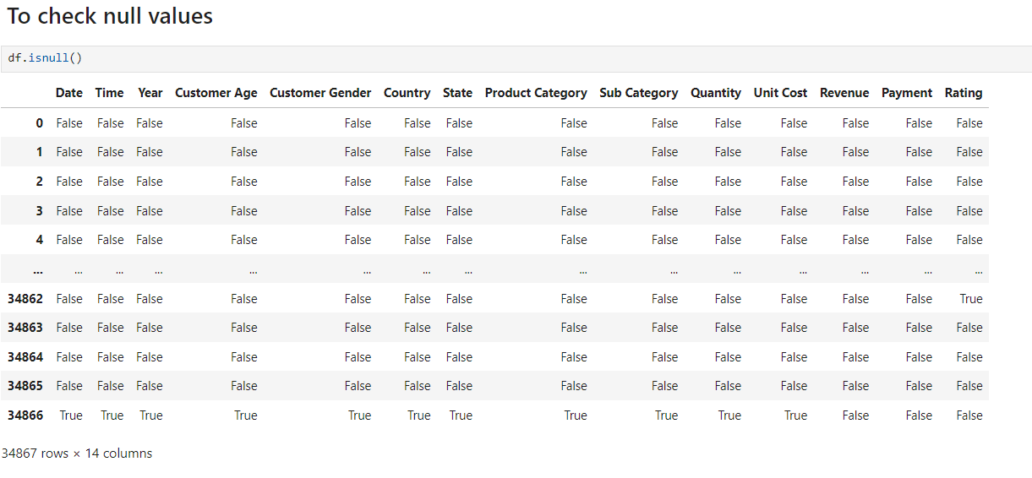

Slide 5
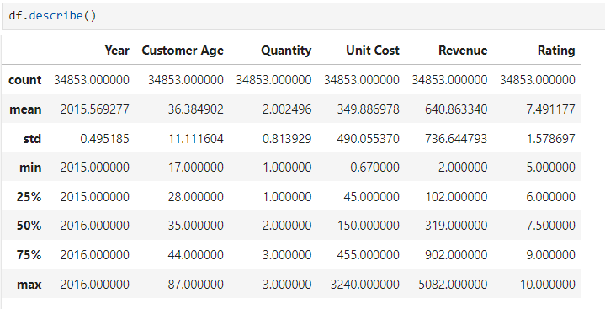

Slide 6
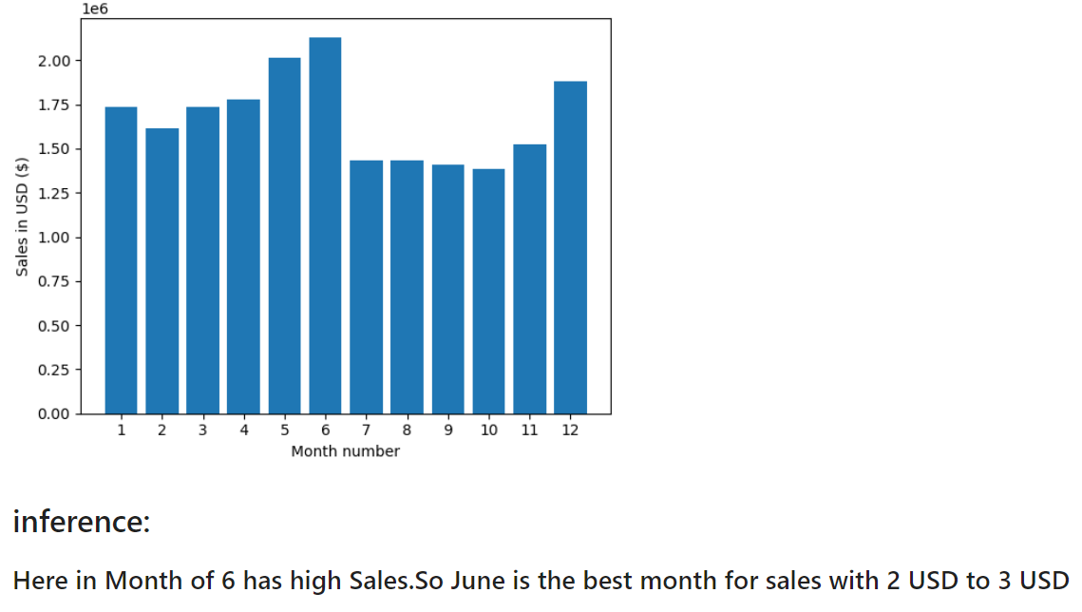
Creating bar plot for sales by month

Slide 7
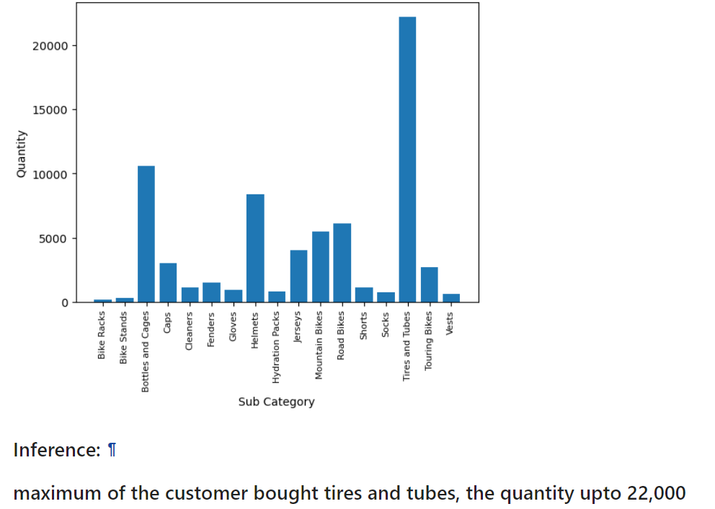
Bar Plot for most sold products based on Quantity

Slide 8
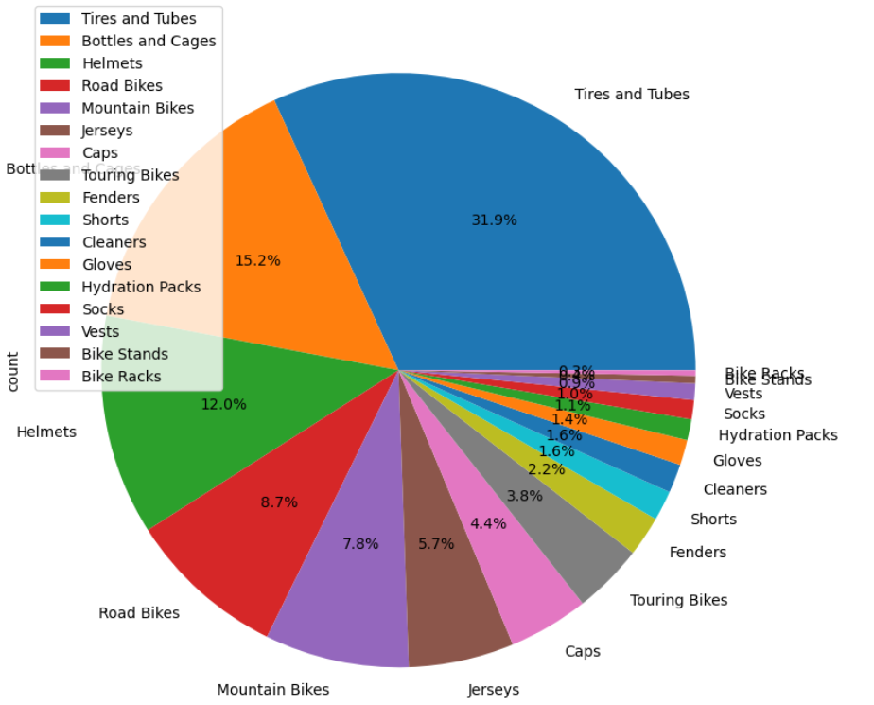

Slide 9
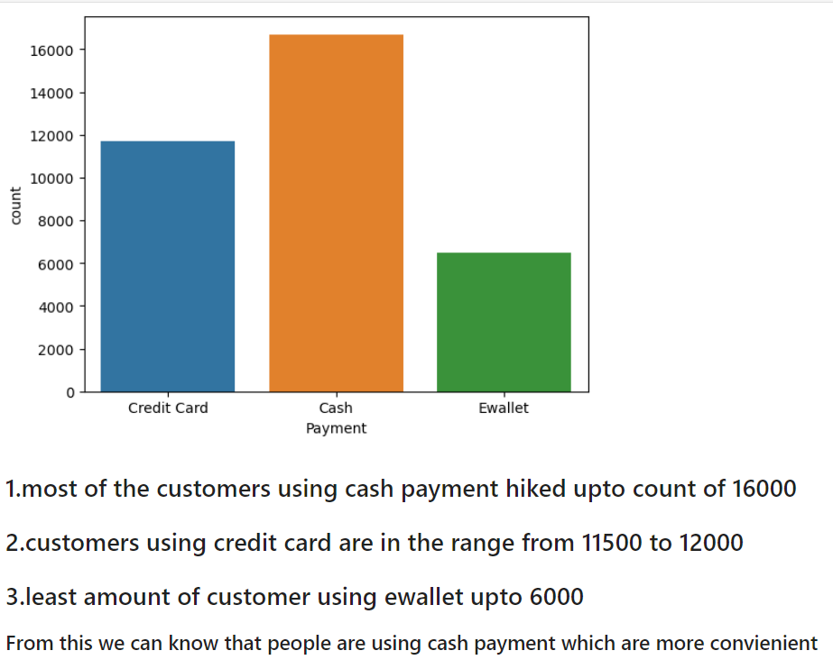

Slide 10
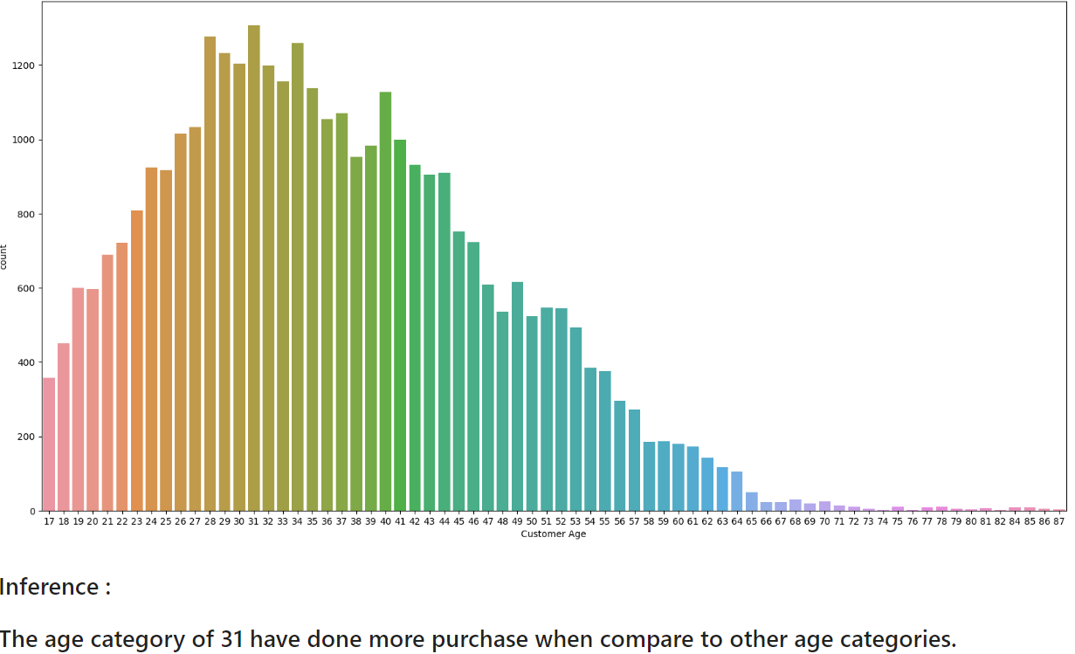

Slide 11
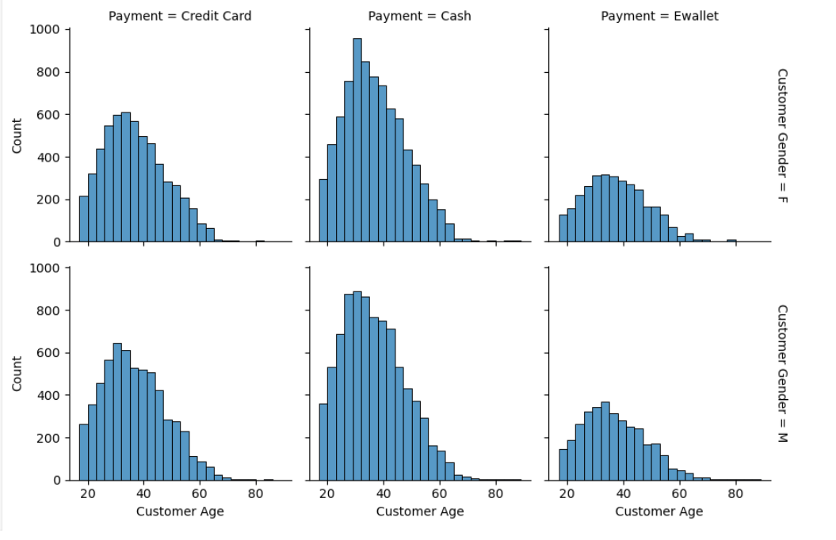
Inference : 1.comparatively female using hand cash more than male 2.women use hand cash count upto 900 3.male use hand cash count nearly 900 1.comparativly male using credit card more than female 2.male using credit card count is 650 3.female using count is nearly 610 1.least amount of customers using ewallet 2.using count of female is nearly 300 3.and the male count is upto 350¶

Slide 12
Conclusion:
effectively collecting, analyzing, and utilizing sales data, companies can make informed decisions that drive revenue growth, enhance customer satisfaction, and ensure long-term success.

